Slide 1
UNION RENEWAL
PRACTICE OF ALLIANCE OF CONCERNED TEACHERS PHILIPPINES
RUBY ANA BERNARDO
SECRETARY
ACT NCR

Slide 2
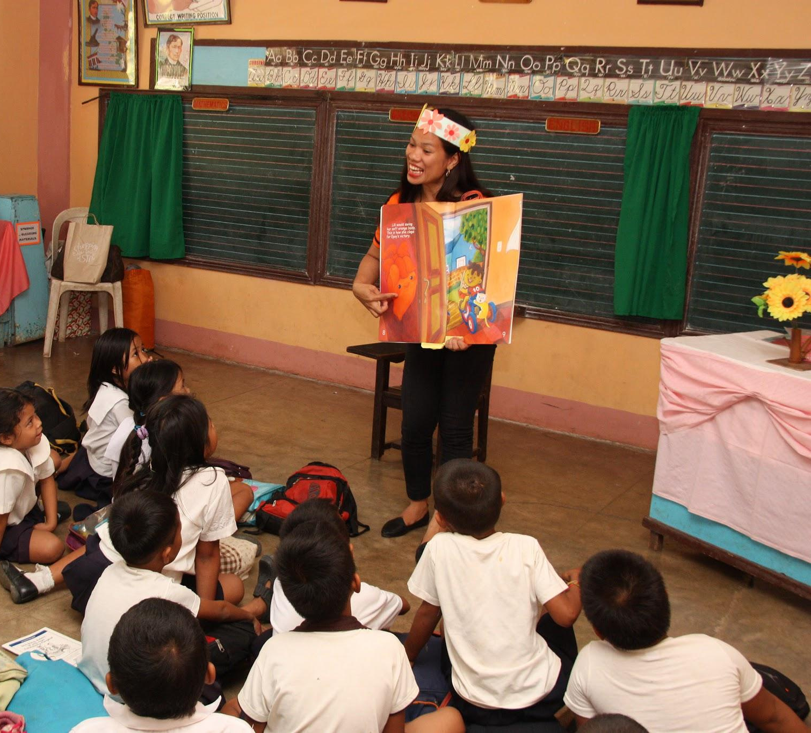
PHILIPPINE CONTEXT
Blatant poverty and inequalities among Filipinos
Education is still a privilege
Overworked underpaid teachers
and education support personnel
Democracy is under attack

Slide 3
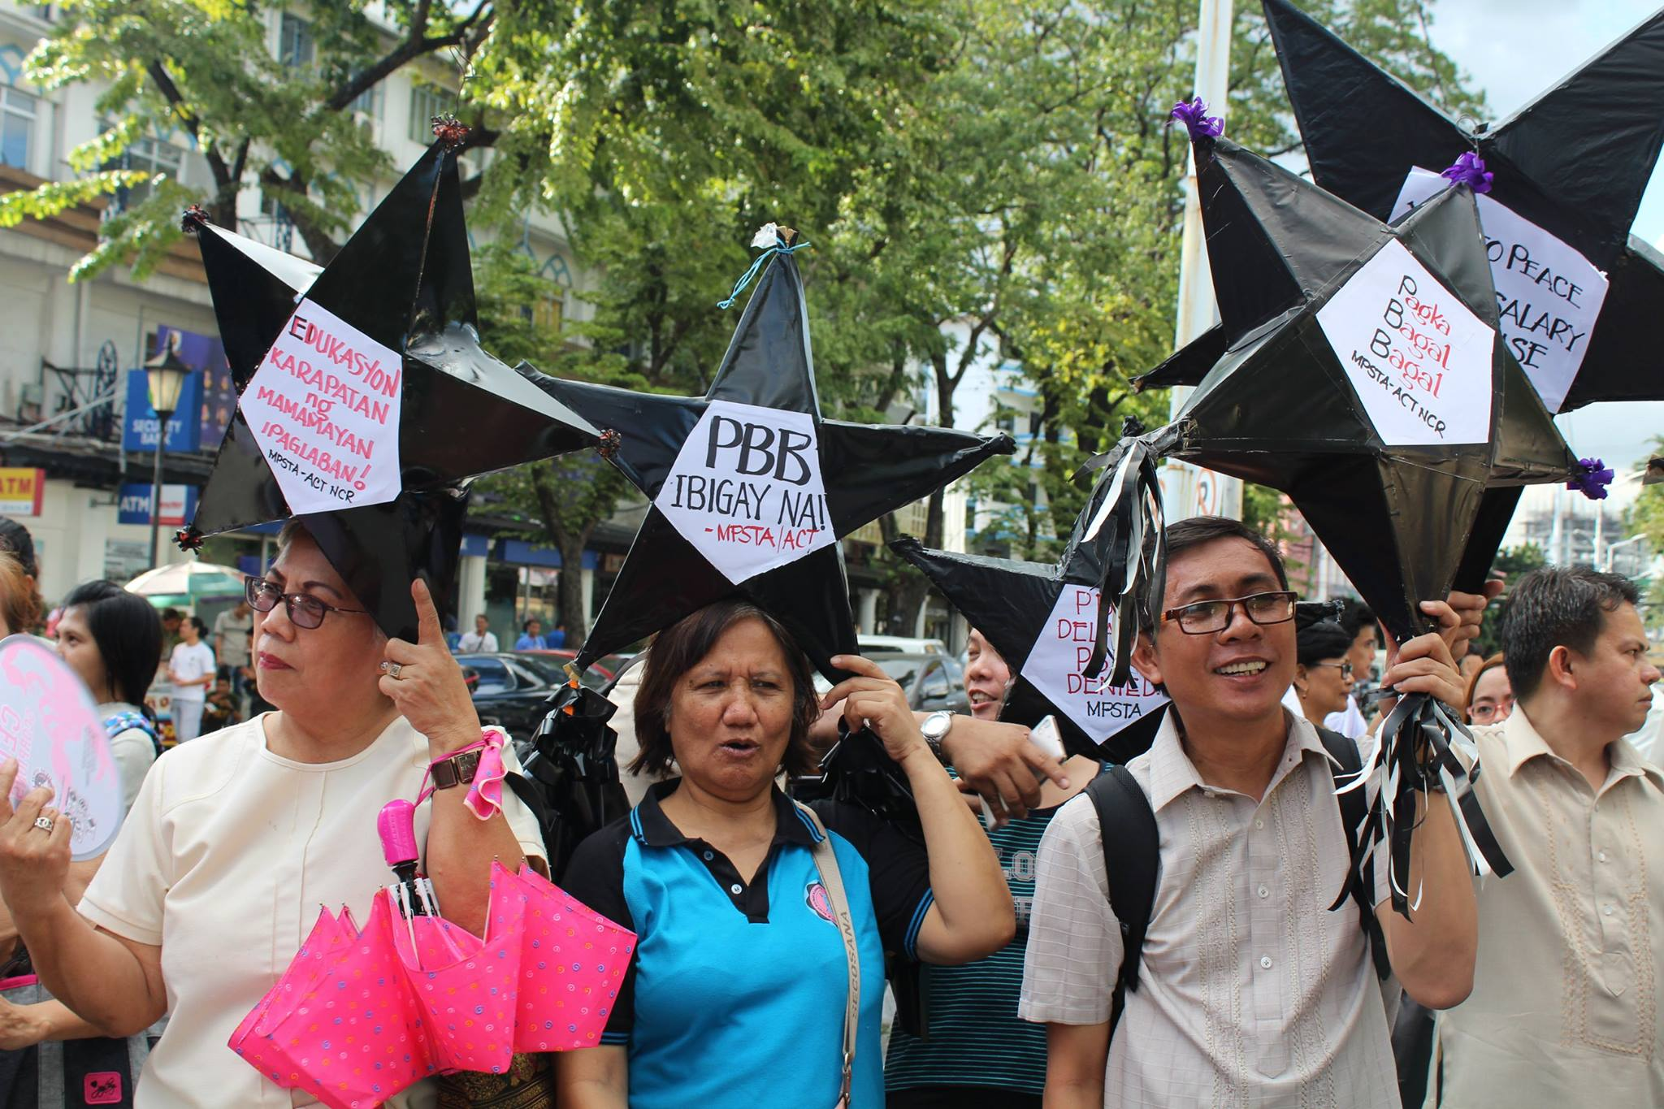
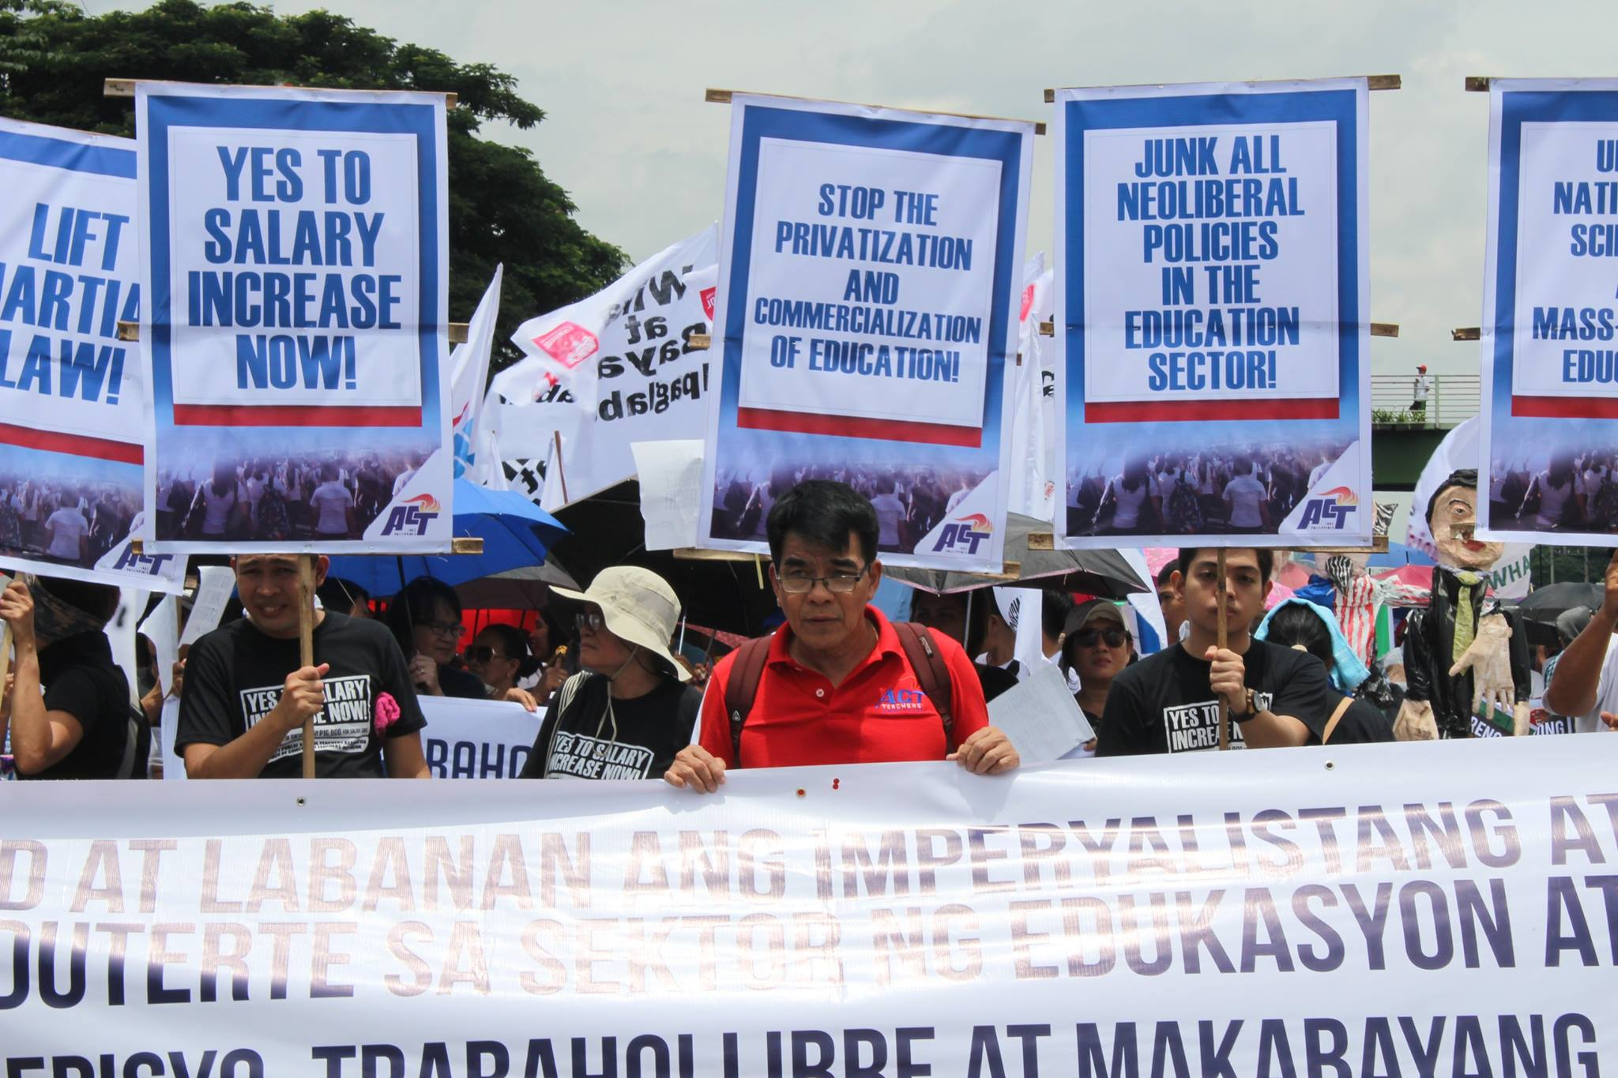
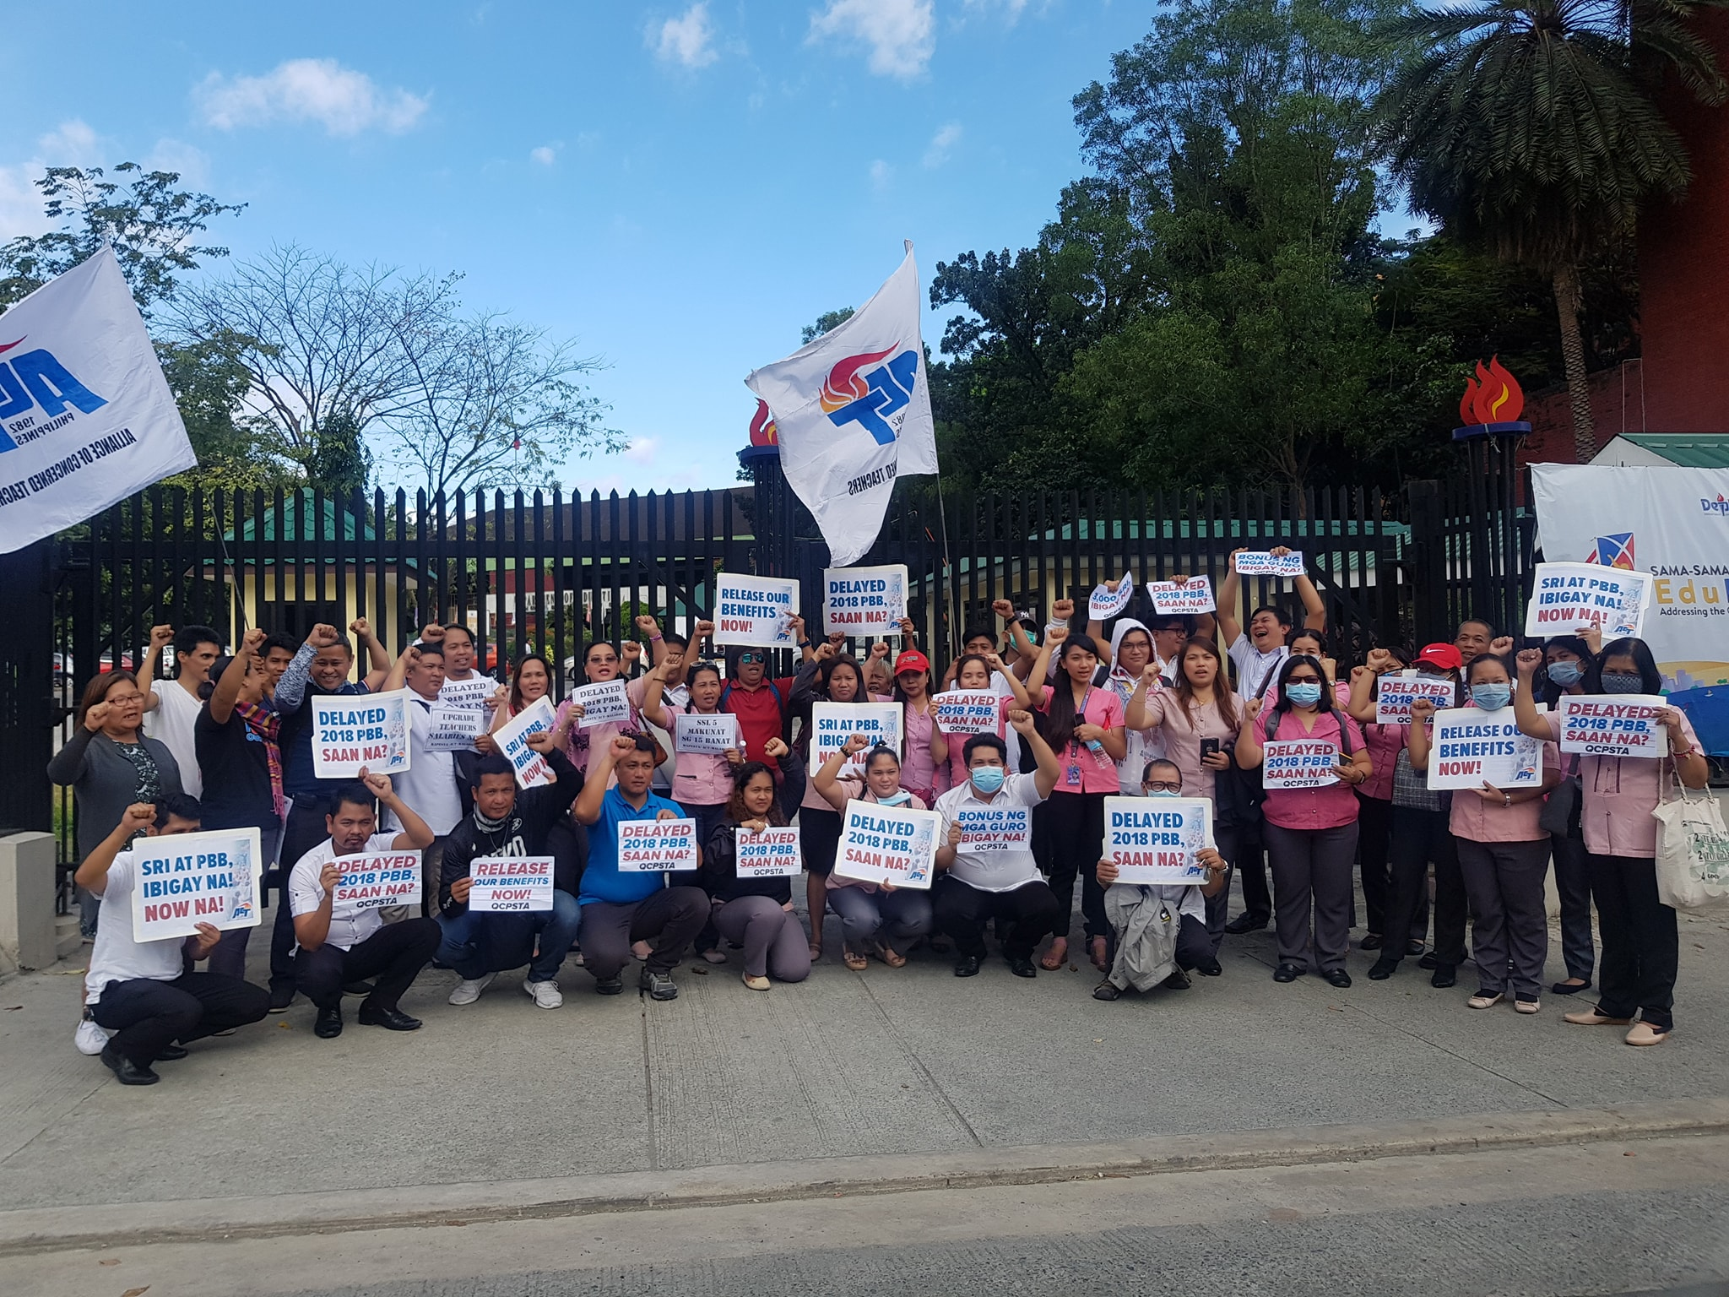
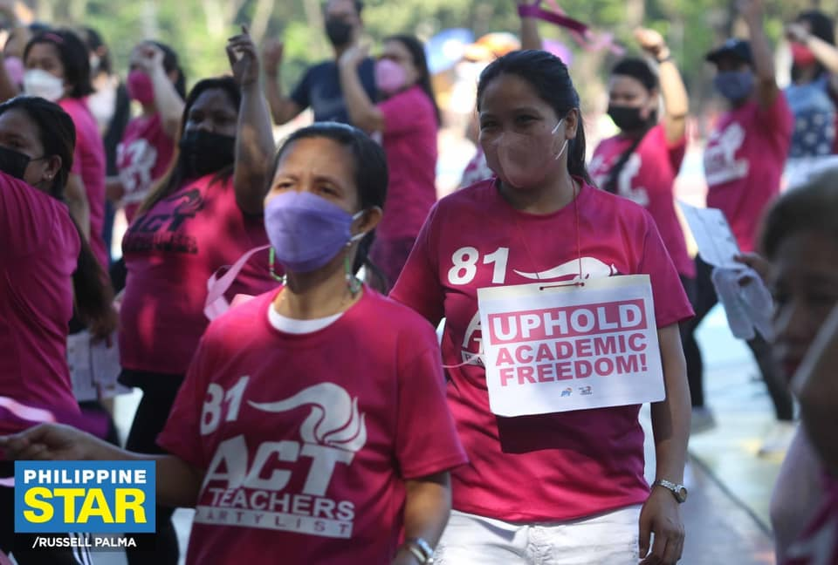
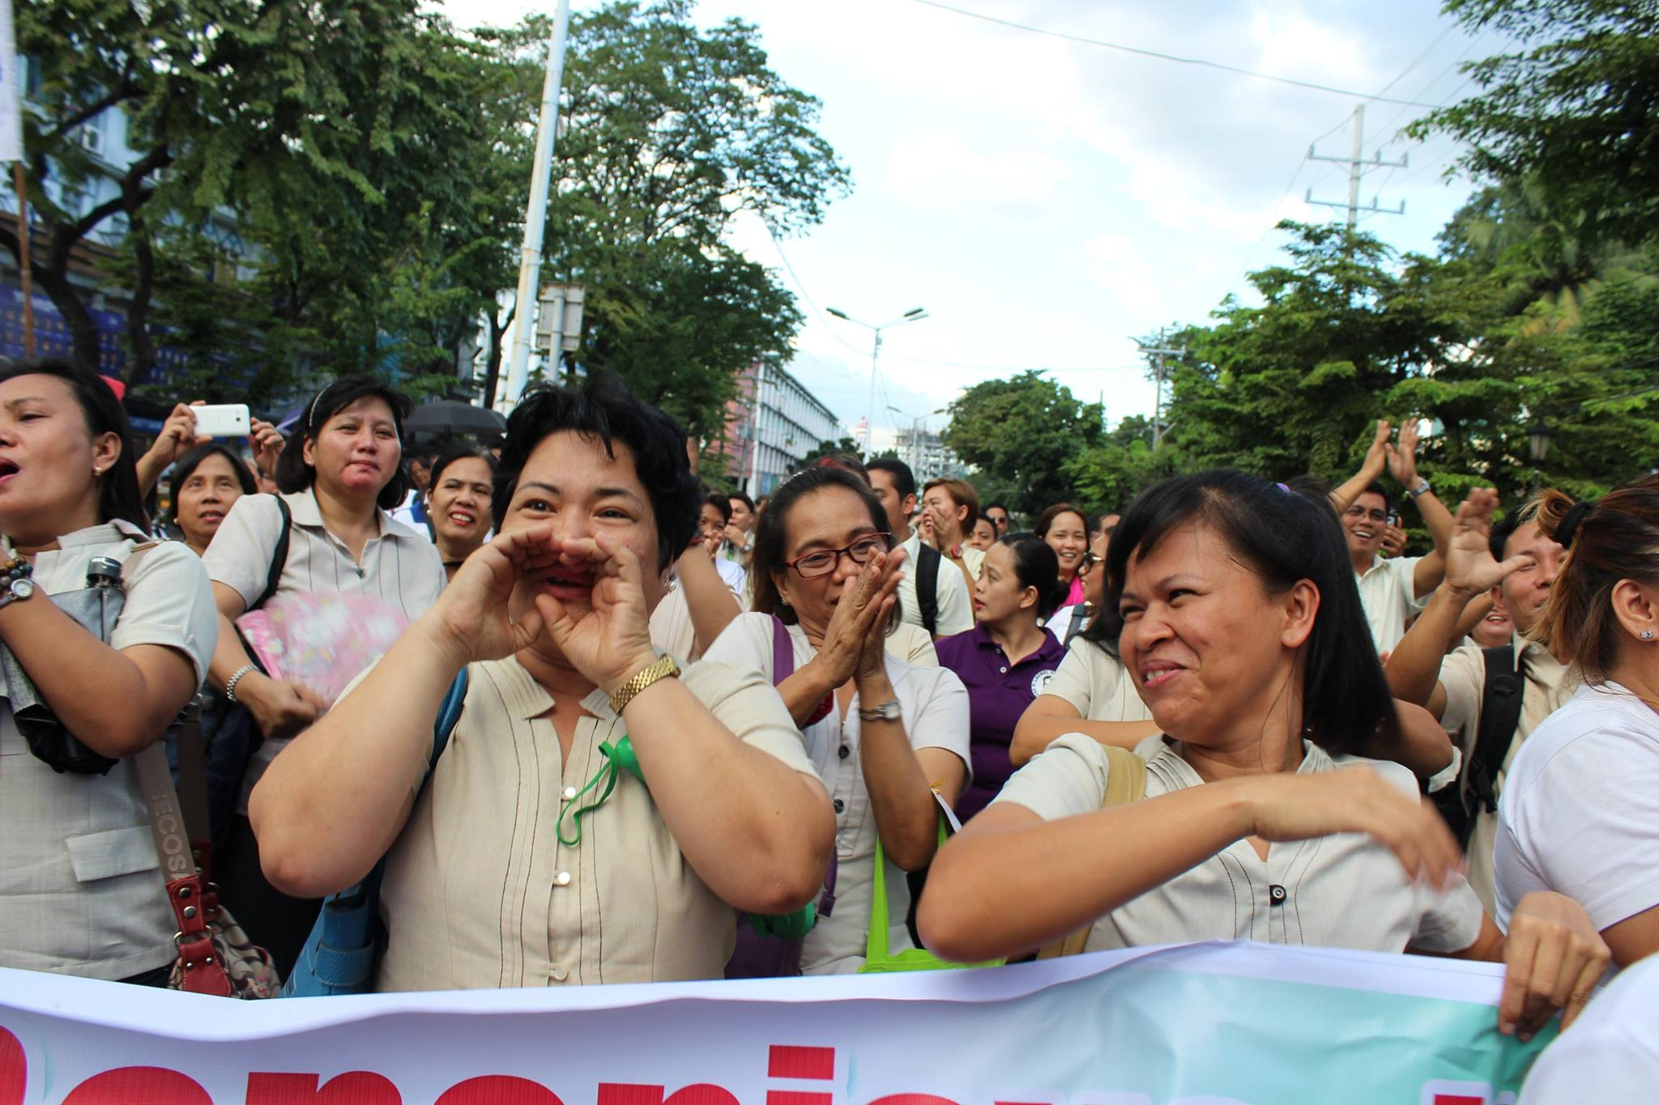
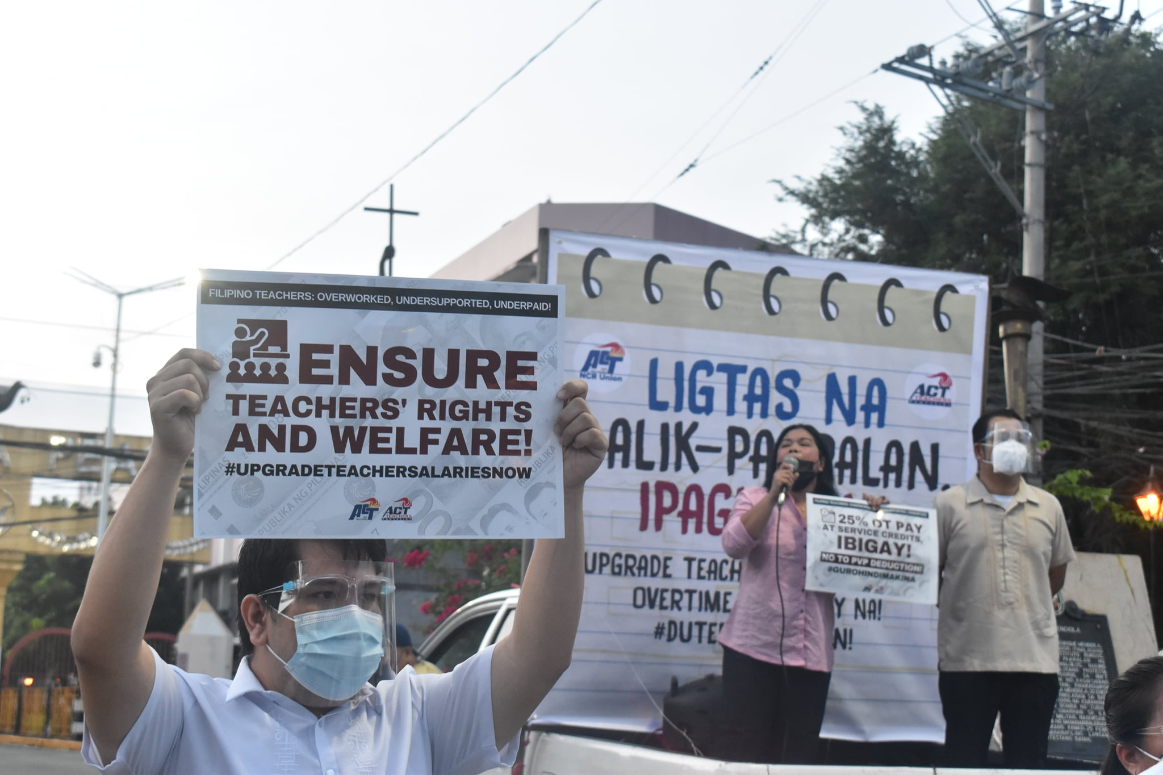
Blatant poverty and inequalities among Filipinos
Overworked underpaid teachers
and education support personnel
Democracy is under attack

Slide 4
Leadership
value of young educators
women leadership
sharing of experiences
democratic process and inclusive consultations

Slide 5
MEMBERSHIP
RECRUITMENT
TEACHER ORGANIZERS
TEACHERS ORIENTATION PROGRAMS
forum discussions and consultations
profile and data banking among our membership

Slide 6
Engagement with members
solid organizing
union must always CONNECT with them
Professional development programs
recognition program for the most active school chapters
Social media is an increasingly important channel of communication

Slide 7
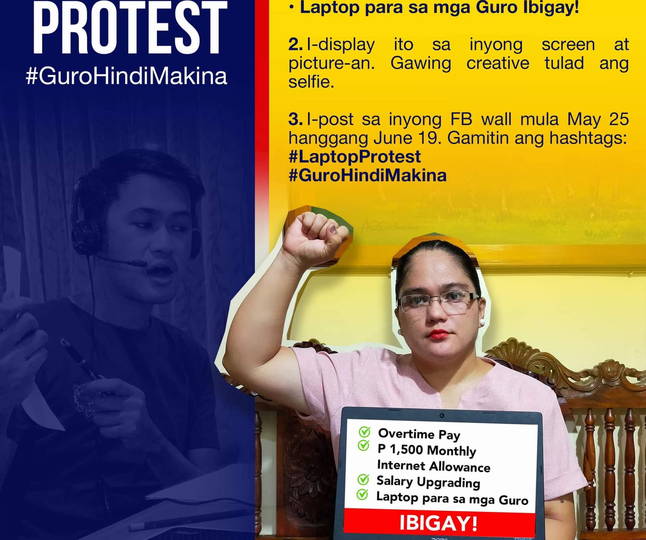
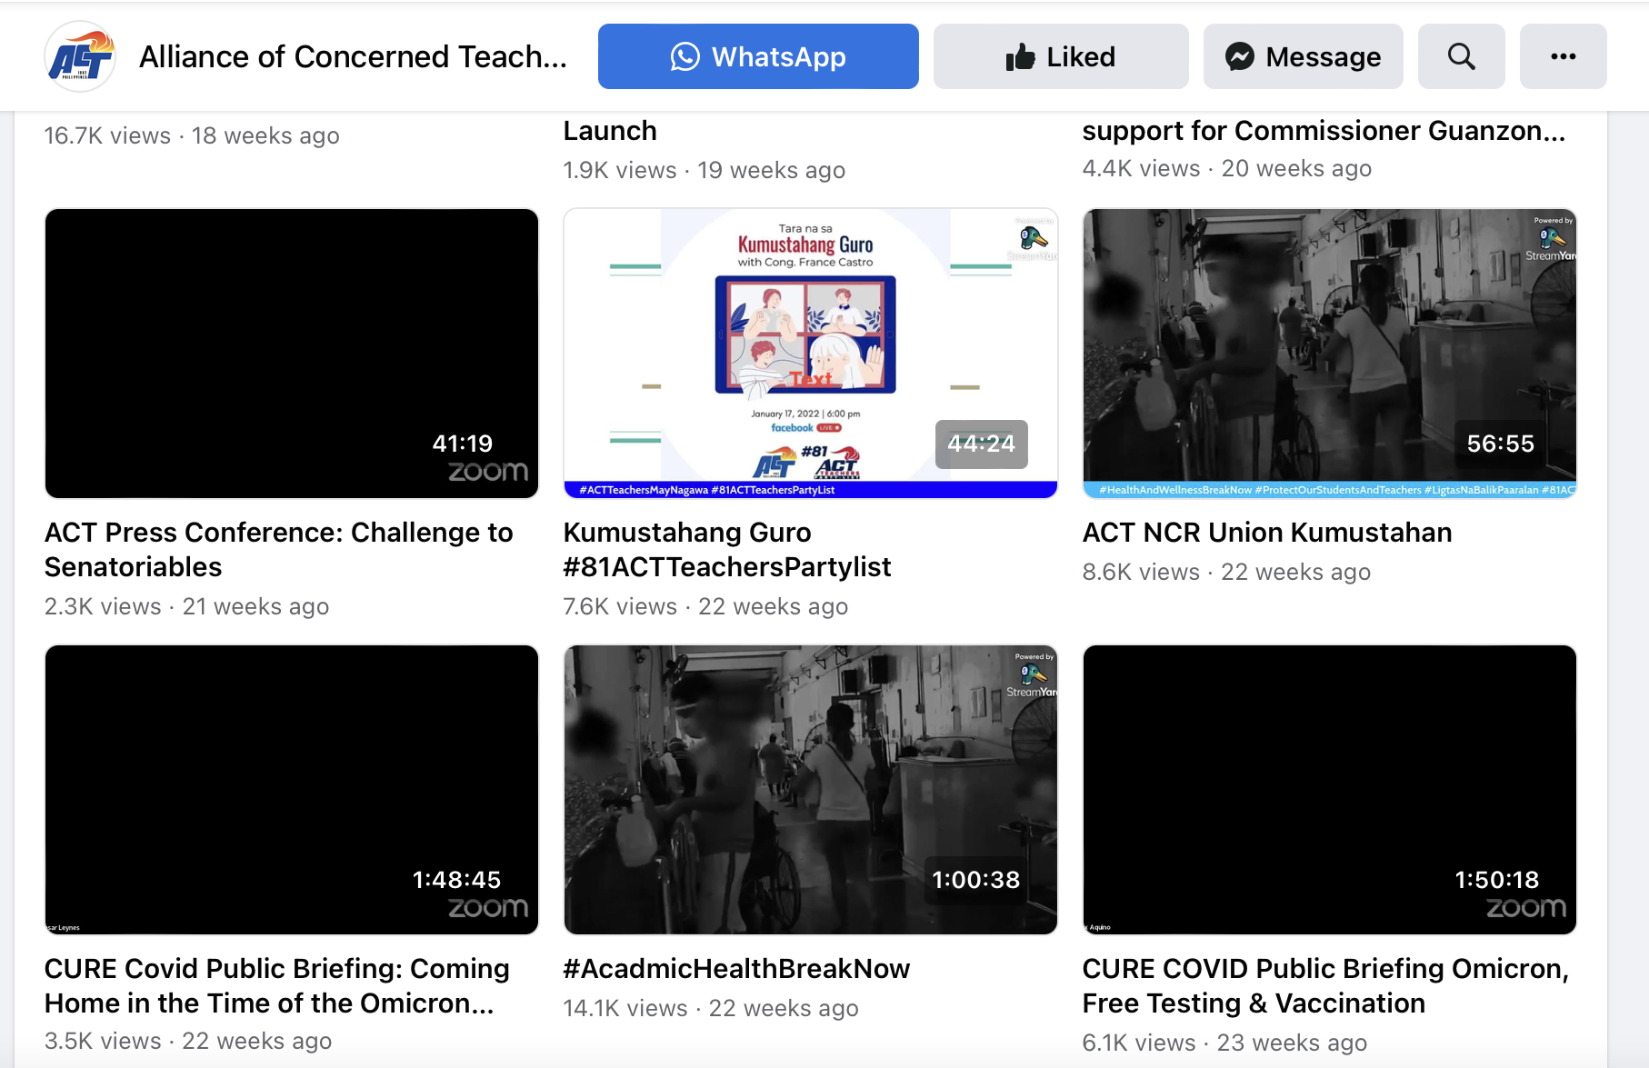
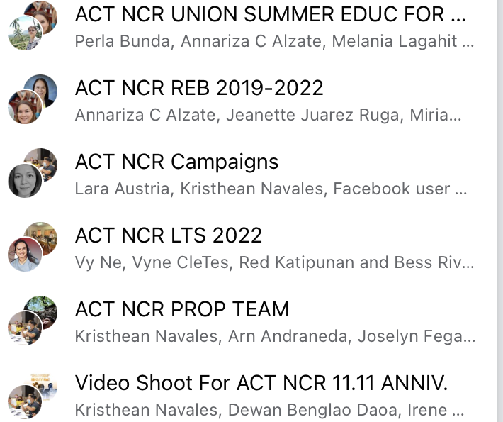
FACEBOOK PAGE
ONLINE PROTEST
ONLINE PROGRAMS
MESSENGER GROUP
FACEBOOK LIVE
FACEBOOK GROUPS

Slide 8
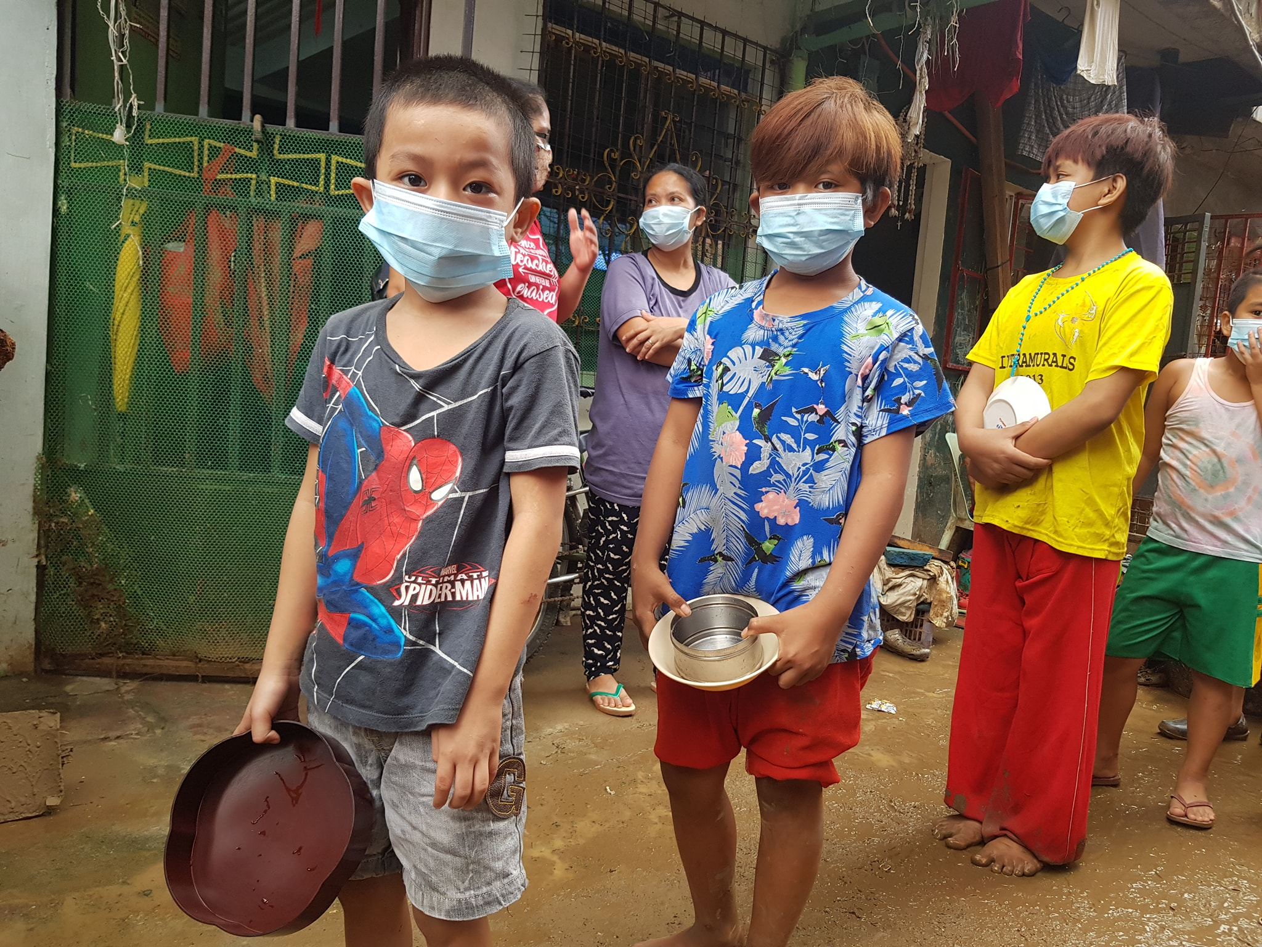
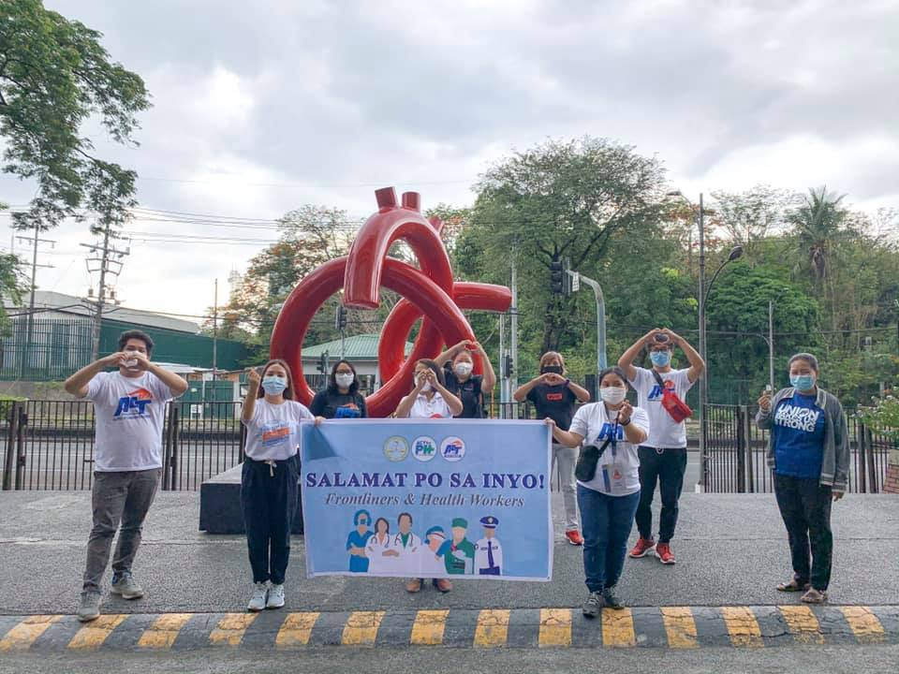
HOW WE ORGANIZE IN TIME OF PANDEMIC

Slide 9
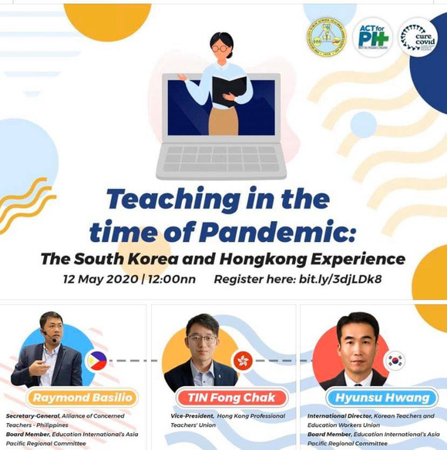
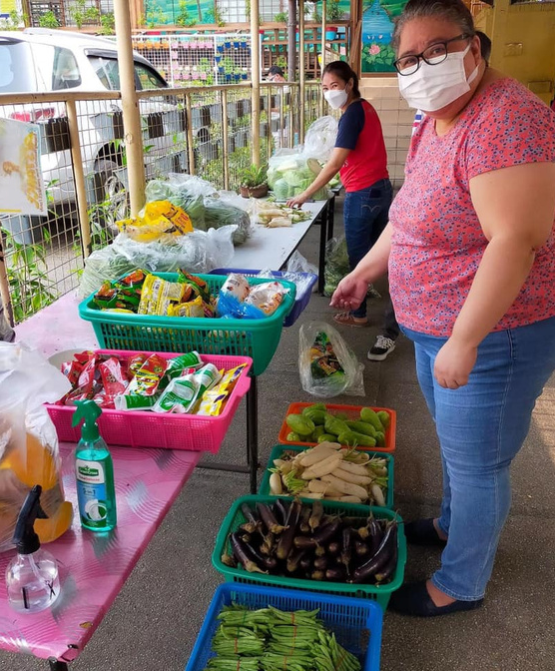
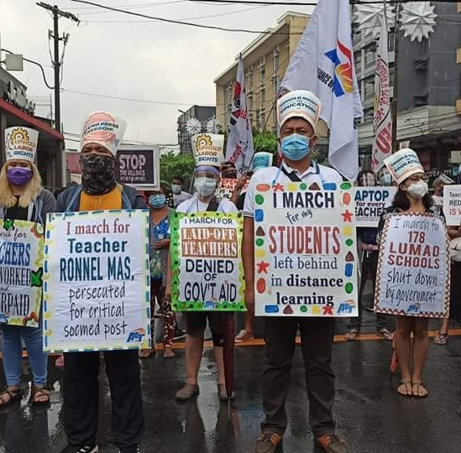
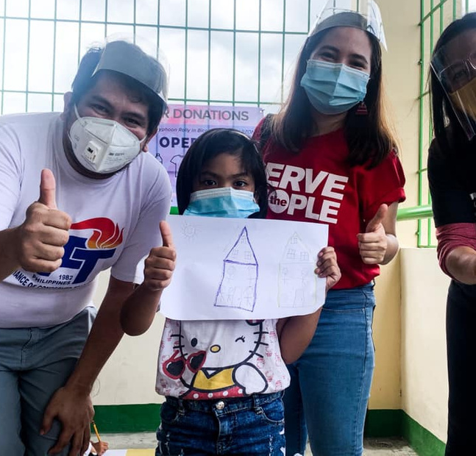
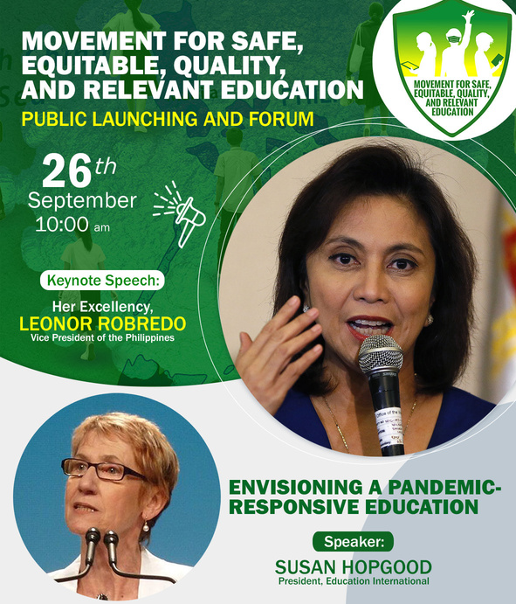
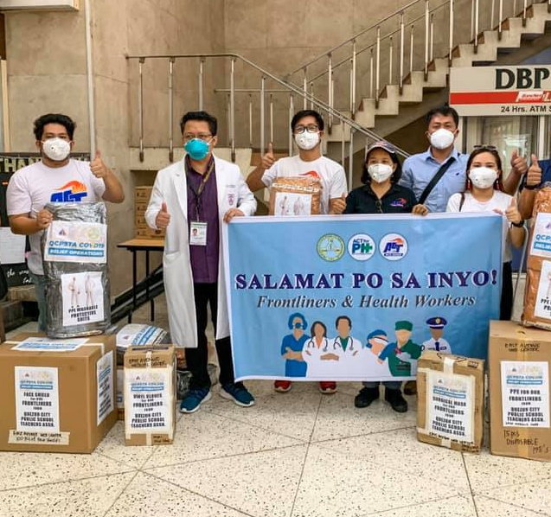

Slide 10
ALLIANCES AND NETWORKS
- Education International and Lärarförbundet
- legislators
- local government
- DepEd Officials
- Principals and School heads
- Media Personnel's and practitioners
- other sectors like the government sectors, women, youth and other progressive organization
- engagement with our VICE PRESIDENT in our safe school campaigns.

Slide 11
TO BUILD BACK BETTER
CONTINUE TO OGANIZE AND MOBILIZE

Slide 12
MARAMING SALAMAT
THANK YOU
SERVE THE PEOPLE

